Slide 1

Entertainer Data Analysis
Iqra Kaularikar

Slide 2
Contents
1
2
3
4
5
Introduction
Given Tasks
Data Preparation & Description
Visuals & Dashboard
Analysis

Slide 3

Introduction
In our daily lives, we often experience stress and the need for relaxation. Finding entertainment through others can be a wonderful way to take a break from the demands of life. It can help alleviate stress and assist us in facing life's challenges more easily. The media and entertainment industry encompasses various forms of entertainment such as film, television, radio, and print. These segments include movies, TV shows, radio shows, news, music, newspapers, magazines, and books. The entertainment industry is a collective term for the sub-industries dedicated to providing entertainment. It is commonly used to describe the mass media companies that control the distribution and production of mass media entertainment.

Slide 4

Given Tasks

Slide 5
Write the process the data added to the current dataset. In addition, mention the theme on which you will be creating the Dashboard.
The data can be added as per ones convenience and comfort.
Then, the data presentation needs to be done.
Build the dashboard.
Build the storyline.

Slide 6
Data Preparation & Description
The data is prepared into three parts :
1.Entertainer Basic Info 2. Entertainer Breakthrough Info 3. Entertainer Last Work Info
Altogether the data is put into Entertainer Final Data.
Since the given data is insufficient for analysis, therefore, additional data is required.
Number of awards and nominees won by them, award from breakthrough etc. are added.
The data is specifically in the form of numeric and alphabetic characters.
Additional data is added from various websites.

Slide 7
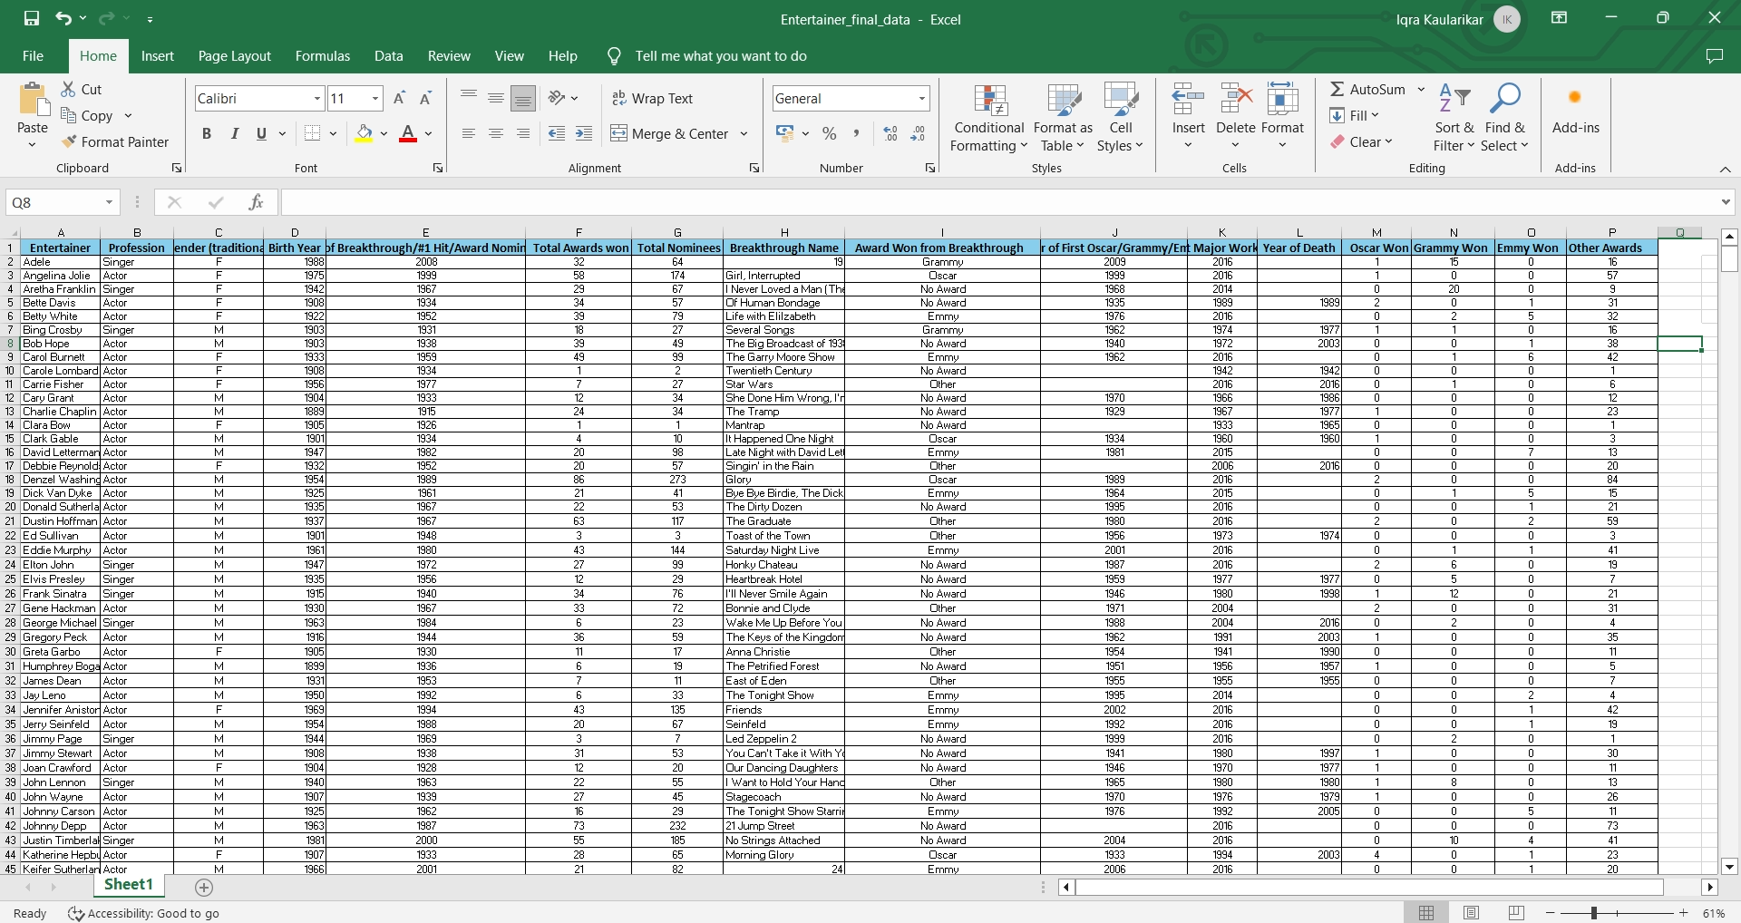
Entertainer Final Data

Slide 8
Column Name Description
Entertainer Name of the Entertainer.
Gender (traditional) Gender of the Entertainer.
Birth Year Birth Year of the Entertainer.
Year of Breakthrough/#1 hit/ Award Year of Breakthrough/#1 hit/ Award Nomination Nomination of the Entertainer.
Breakthrough Name Name of breakthrough album / show.
Year of first Oscar/Grammy/Emmy Year of 1st won mega award.
Year of Last Major Work (arguable) Last major album or show or movie.
Year of Death Entertainer’s death year, if any.
Award won from Breakthrough Any award/s from breakthrough.

Slide 9
Total Awards Won Total awards won by the Entertainer.
Total Nominees Total nominees chosen for awards.
Profession Category of Entertainer(singer/actor).
Oscar won Total number of Oscars awards won.
Grammy won Total number of Grammy awards won.
Emmy won Total number of Emmy awards won.
Other Award Total number of other awards won.

Slide 10
The cool part of being an entertainer is getting the opportunity to get your feet wet in all areas. Paula Abdul
“
”

Slide 11
Visuals And Dashboard
Distribution of Entertainers into respective categories in accordance of their art.
Pop stars, dancers, rock stars etc. added into “Singers”.
Hosts and various ground actors are counted under “Actors”.
Some allrounders (singers as well as actors) are added according to their main art.

Slide 12
Pie Chart By Gender

Slide 13
Total Awards Won & Nominees

Slide 14
Most Awards Won

Slide 15
Top 15 Entertainers

Slide 16

Analysis
Meryl Streep is the best entertainer with 177 total wins including 3 Oscars and 3 Emmys also she has 540 nominees.
Most of the Entertainers are From Actors category.
Katherine Hepburn has the Highest Oscars (4).
Oprah Winfrey has the Highest Emmies (18).
Stevie Wonder has the Highest Grammies (24).
Stevie Wonder has the Highest Known awards (24 Grammies + 1 Oscar).
There are very less entertainers who won awards from their breakthrough.

Slide 17

Thank you
Iqra Majid Kaularikar
iqrakaularikar@gmail.com

